Slide 1
THE COCA-COLA COMPANY (KO)
63
YEARS
63 Years of Coca-Cola Stock in 3 Charts
I downloaded the data expecting a smooth line going up. That's not what I found.

Slide 2
THE SETUP
Coca-Cola is the textbook "safe" stock.
Then I looked at the data.
Everyone knows the brand. Everyone drinks the product.
So I assumed the chart would be boring.
KO | 1962 - 2025
2 / 9

Slide 3
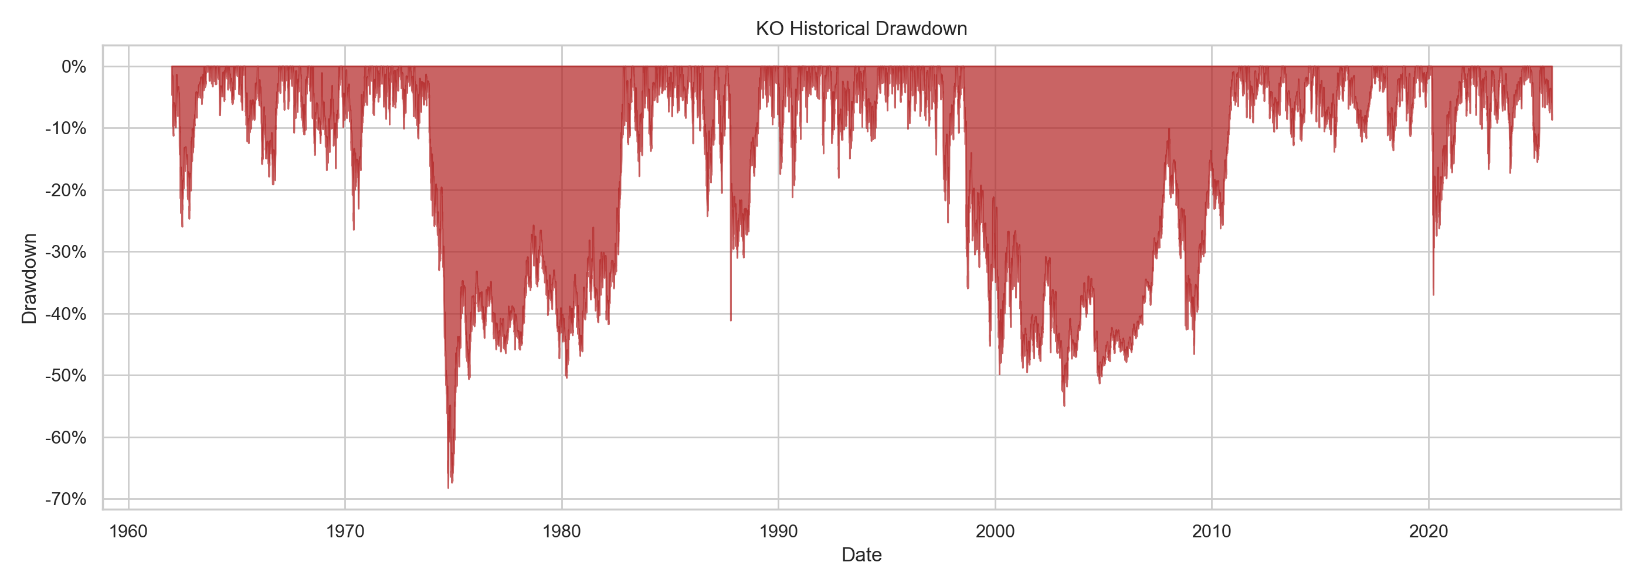
CHAPTER 1 | THE PAIN
Patience was tested, hard.
In 1973-74, KO fell roughly 68% from peak to trough, then took close to a decade to get back.
After peaking in 1998, it spent about 12 years underwater, bottoming near -55% in 2003.
Imagine holding the world's most trusted beverage company through that.
KO | 1962 - 2025
3 / 9

Slide 4
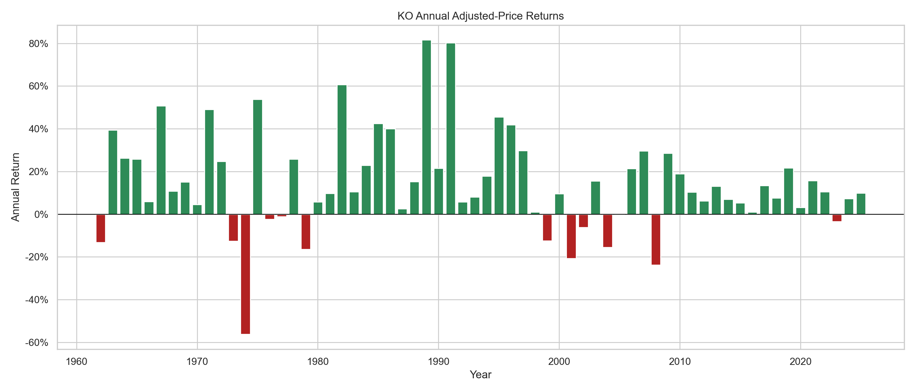
CHAPTER 2 | THE SWINGS
Wide swings, mostly positive.
Annual returns ran from about -56% in 1974 to over +80% in both 1989 and 1991.
Most years were positive, but 2001 and 2008 each cost investors more than 20%.
Since 2010, returns have been steadier: single digits to low double digits, no more 40%+ years.
KO | 1962 - 2025
4 / 9

Slide 5
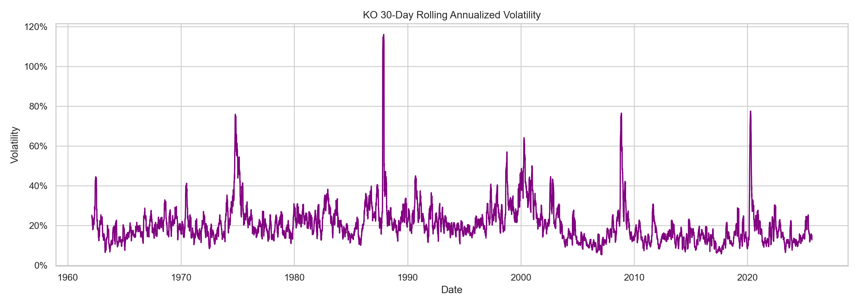
CHAPTER 3 | THE FEAR
The spikes read like a history book.
1974: the bear market
1987: Black Monday, over 110%
2008 financial crisis and 2020 COVID: around 75%
Between crises, KO has settled into a calmer 10-20% range, vs. 20-30% in earlier eras.
KO | 1962 - 2025
5 / 9

Slide 6
WHAT I TOOK AWAY
A "safe" stock isn't the same as a smooth ride.
The company didn't stop being great. The price just didn't care for a very long time.
Even one of the world's most trusted brands went through brutal drawdowns and long stretches of going nowhere.
KO | 1962 - 2025
6 / 9

Slide 7
THEN SOMETHING CHANGED
Since 2010, the ride got calmer.
0
10-20%
-37%
years above +40% since 2010
typical 30-day volatility in recent decades, vs. 20-30% before
the 2020 COVID drop, and it healed far faster than 1974
KO | 1962 - 2025
7 / 9

Slide 8
SAME COMPANY, DIFFERENT RIDE
Two crashes. Two very different waits.
1974
2020
-68%
-37%
Close to a decade to recover.
Recovered far faster.
Same brand. What changed was how long the pain lasted.
KO | 1962 - 2025
8 / 9

Slide 9
THE LESSON
Time horizon matters as much as the company you pick.
Know your tolerance for a -50% year before you need it.
What's the deepest drawdown you've ever sat through? Did you hold, or sell?
Data: KO historical stock prices via Kaggle. Charts are my own analysis. Not financial advice. Past performance doesn't guarantee future results.
KO | 1962 - 2025
9 / 9

